Slide 1


QUILL
CO₂ Capture from Commercial Flue Gas Process Streams
Michael Sweeney
Primary Supervisor: Dr. Leila Moura
Co-supervisor: Prof. John Holbrey
Start Date: Oct 23
25th March 2024

Slide 2
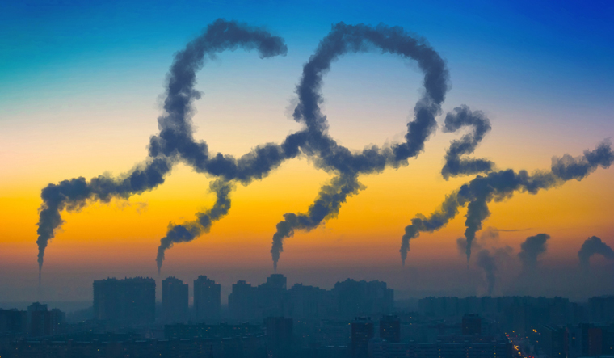
Background of the project
QUILL
Carbon dioxide (CO₂) emissions play a pivotal role in climate change, EU have signed on to stop global temperatures rising above 1.5⁰C greater than pre-industrial temperature.¹
Aim to reduce emission by 2030 by 55% from level of 1990
Carbon Neutral by 2050
CO₂ capture needed across sectors, recycling, H₂ production
Technical report from 2018 says there are serious problems with implementation and operation of CO₂ capture systems²
1) Regulation (EU) 2021/1119 2) Schlissel D (2018) Holy Grail of carbon capture continues to elude coal industry. Technical report
Notes:
The four CCS initiatives reviewed here can all be categorized as experimental, and none of the experiments have gone well. Two in essence have been abandoned (Edwardsport and Kemper) and two (Boundary Dam and Petra Nova) are only economically viable by selling the captured CO2 for use in EOR which, in turn adds more CO2 to the atmosphere.
Meanwhile, the utility has had to pay millions of dollars for temporary units that boost the capacity of the system’s thermal reclaimer, the unit that purifies the amine solution used to strip CO2 and sulfur dioxide from the plant’s flue gases. The amine solution has been degrading faster than anticipated, overwhelming the plant’s installed reclaimer and forcing the utility to bring in mobile units.9 The fix has worked, but according to a report prepared for SaskPower, it is “not economically sustainable.”10
So far at a reduction of 26% of 1990 level

Slide 3
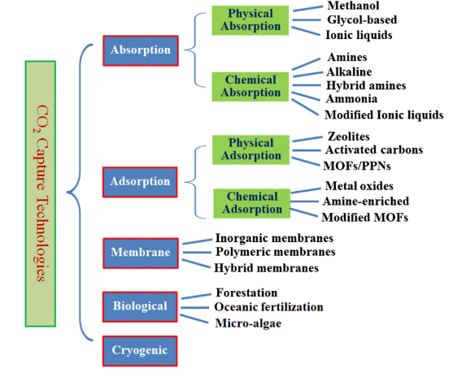
Other CO₂ capture methods
QUILL
X. Wang et al, Front Energy Res, 2020, 8, 560849.
Notes:
Different routes of CO2 uptake that have been explored. Each has their respect drawbacks.
Cryogenic is very energy intensive
Biological has time constraints forests don’t grow overnight
Membranes degrade quickly and have high maintenance costs
Solids adsorbents have drawback from cleaning and high regeneration cost.
Physisorbants have a lower uptake that chemisorbent materials and rely on pressure Low henry’s constant higher solubilty
Chemisrobents somethings require high temperature

Slide 4
Goals of the project
QUILL
Investigate the chemisorption properties in ionic liquids for CO₂ capture
Further understand the effects of water on CO₂ capture by ILs
Build a database for CO₂ capture in ionic liquids (Poster)
Physical
Ideal
Liquid
Sorbent
Chemical
Fast kinetics
Reversibility
Low reaction heat
Chemical stability
Thermal stability
Water tolerant
Low volatility
Low viscosity
G. L. P. Aydos et al, ChemSusChem 2023,16, e2023009
Notes:
Amine

Slide 5
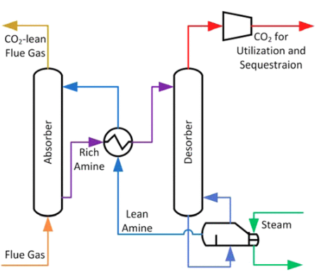
Introduction
QUILL
What is flue gas?
Post-combustion exhaust, primarily N₂, 3-15% CO₂, O₂ & water vapour with other trace impurities (CH₄/NO_{x}/SO_{x})¹
Current industrial standard?
The current industrial standard for CO₂ capture are amine scrubbers, most commonly monoethanolamide (MEA) and other amine blends commonly methyl diethanolamine (MDEA) & piperazine (PZ)
Drawbacks;
Very viscous diluted in water to 30 %wt. Water high heat capacity energy intensive to heat to desorption temperatures
Degrade into corrosive by-products
Copied²
Nitramide
Nitrosamines
1) X. Wang et al, Front Energy Res, 2020, 8, 560849.| 2) B. Dutcher et al, ACS Appl Mater Interfaces, 2015, 7, 2137–2148. |3) NPL REPORT (RES) 1613 |4) Akram eta al, Int. J. Greenhouse Gas Control 95 (2020) 102
Notes:
Amine

Slide 6
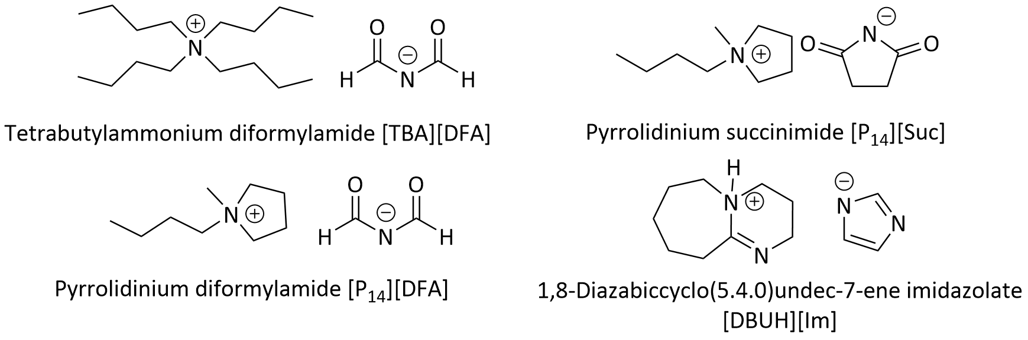
Practical work
QUILL
Currently look at these superbasic ILs¹ for their chemisorption properties with CO₂
Will test the pure CO₂ uptake and then CO₂/N₂ mixture with different levels of water content.
1) Angel et al, J Electrochem Soc, 2022, 169, 086502.

Slide 7
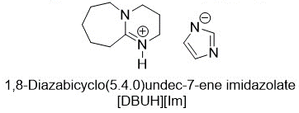
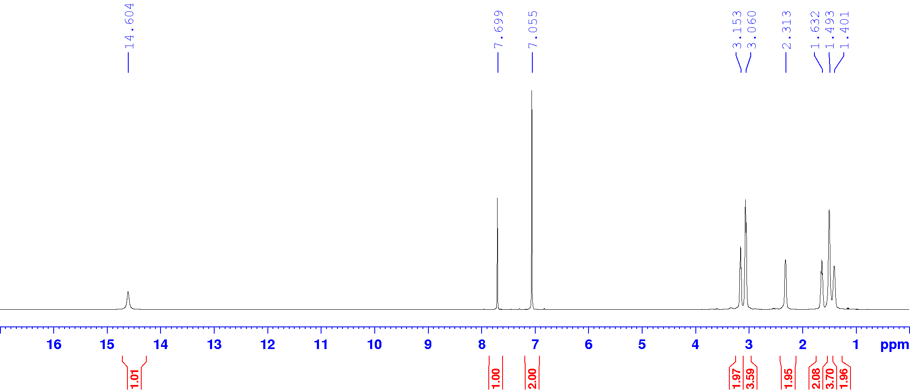
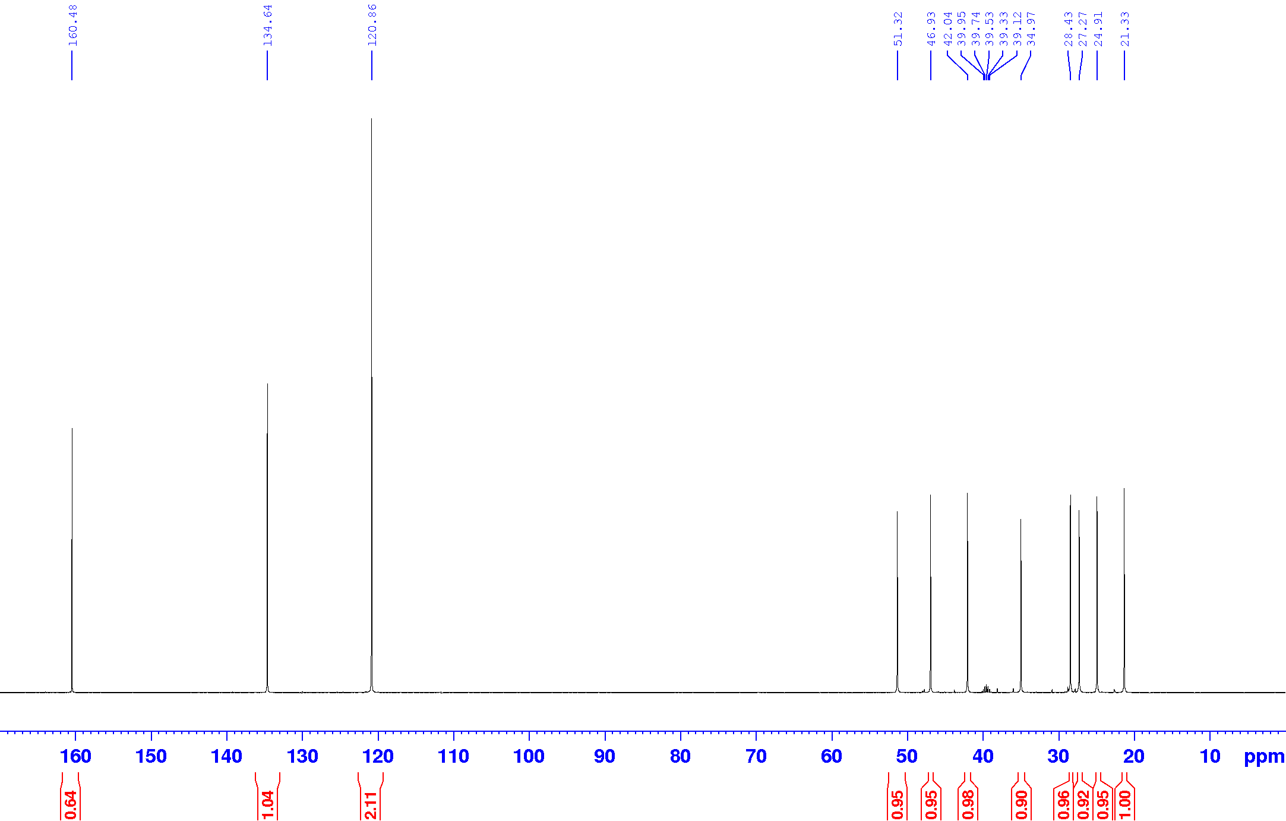
Practical work
QUILL
E
F
G
H
D
I
L
C
J
B
K
^{c}A
^{H}A
J,K
J,K
L
F,G
L
D
C,E
^{C}A
L
I
C E
H
I
B
D
F
B
H
^{H}A
¹H NMR (DMSO-d₆), 400MHz
¹³C NMR (DMSO-d₆), 400MHz

Slide 8
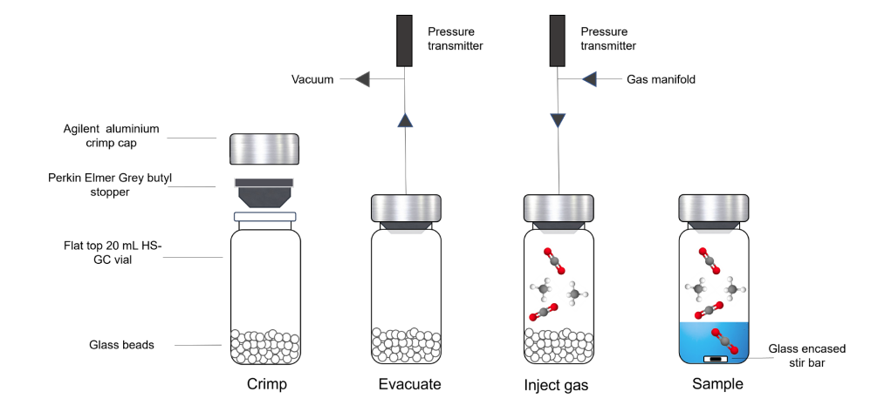
Methodology
QUILL
CO₂ uptake will be determined by GC-HS method devised by Young et al
Young et al, ACS Sustainable Chem. Eng. 2023, 11, 17787−17796

Slide 9
Quantifying CO₂ uptake
QUILL
Equilibrium time @35 ⁰C
Pressure Range
Readable Range
ACS Sustainable Chem. Eng. 2017, 5, 8192−8198
Notes:
Red lines are the pressure range in which the calibration curve is an optimal accuracy.

Slide 10
Database
QUILL
Filtering papers for just CO₂ chemisorption ILs, excluding:
Membranes
Polymerised ILs
Grafted / encapsuled ILs
Porous liquids
Amines & amine blends.
Capture all the physical parameters reported,
Temperature
Pressure
Viscosity pre-CO₂ & post CO₂
Density
Water content
Desorption energy/absorption energy.
Complimentary structural database
Molecular weights
pKa
Abbreviations
# appearances
Example;
Cation | Anion | M_{w} (g/mol) | Water Content (wt%) | Pressure (mbar) | Temp. (K) | CO₂ mol/mol IL | CO₂ mol/kg IL | CO₂ g/kg IL | Mole Fraction | Vis. Pre CO₂ (mPa.s) | Vis. Post CO₂ (mPa.s) | Desorb. Temp. (K)
[(P2-Et)H] | [PhO] | 433.5 | <0.1 | 1000 | 296.2 | 0.45 | 1.04 | 45.69 | 0.31 | - | - | 353
[MTBDH] | [PhO] | 247.3 | <0.1 | 1000 | 296.2 | 0.49 | 1.98 | 87.20 | 0.32 | - | - | 353
[MTBDH] | [Im] | 221.22 | <0.1 | 1000 | 296.2 | 1.03 | 4.66 | 204.91 | 0.51 | - | - | 353
[MTBDH] | [TFE] | 253.27 | <0.1 | 1000 | 296.2 | 1.13 | 4.46 | 196.40 | 0.53 | - | - | 353
Wang et al, Angewandte Chemie International Edition, 2010, 49, 5978–5981
Notes:
Superbasic relies on the pKa of the anion for absorption and the

Slide 11
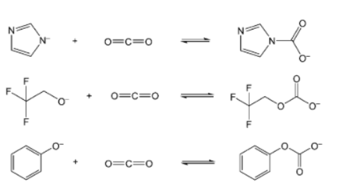
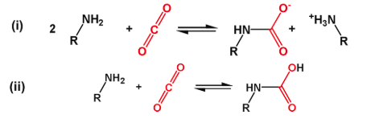
Database
QUILL
Initial insights from the database include the important of the presence of water, small amounts can increase rate of absorption but can have a negative effect on capacity.
The primary reaction is a carbamate formed with the anion or when water is present there are bicarbonate species present.
Copied²
Copied¹
1) Wang et al, Angew. Chem. Int. Ed. 2010, 49, 5978-5981 2) Latini et al, Journal of CO2 Utilization 2022, 55, 101815
Notes:
Superbasic relies on the pKa of the anion for absorption and the

Slide 12
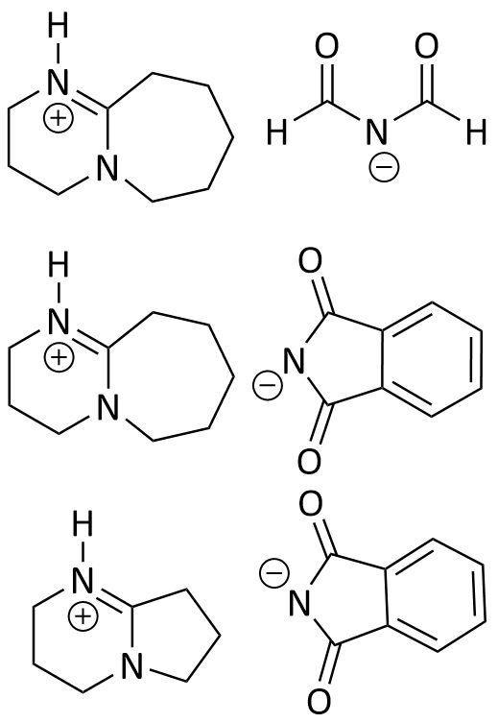
Future Work
QUILL
Potential Cations | Potential Anions
Continue with CO₂ uptake testing varying;
-Temperature -Water content
-Test CO₂/N₂ mixtures
1,8-Diazabicyclo[5.4.0]undec-7-ene (DBU)
Phthalimide (Phth)
Continue with the adding papers to the database
Investigate new superbasic ILs
1,5-Diazabicyclo[4,3,0]non-5-ene (DBN)
Diformylamide (DFA)
Journal of Molecular Structure 1299 (2024) 137133, ACS Sustainable Chem. Eng. 2017, 5, 8192−8198
Notes:
Superbasic relies on the pKa of the anion for absorption and the

Slide 13


Acknowledgements
QUILL
With thanks to:
Dr. Leila Moura
Prof. John Holbrey
Chevron
Mark Young
Sam McCalmont
Beth Murray
Dr. Yoan Delavoux
QUILL
QUESTIONS?
Funded by CAST Award in Partnership with Chevron & Department of Economy NI

